Slide 1


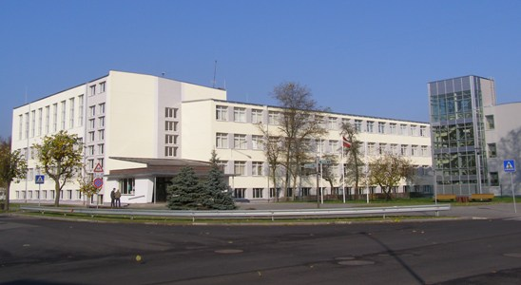
Lifelong Learning Multilateral School Project
WE ALL CAME HERE FROM SOMEWHERE
Olaine Secondary School No 1
2012

Slide 2
Diversity, identities and citizenship.
Let's celebrate tolerance and peace
Meeting in Scotland, Inverness 6th-10th March, 2012

Slide 3
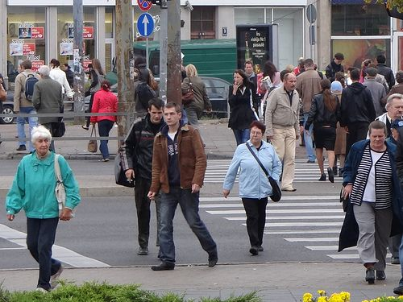
SOME HISTORICAL BACKGROUND
Latvia is a culturally diverse country, but this diversity in some ways is paradoxical because it does not include some of the main aspects of European diversity in the 21st century.
Native inhabitants of Latvia are Latvians.

Slide 4
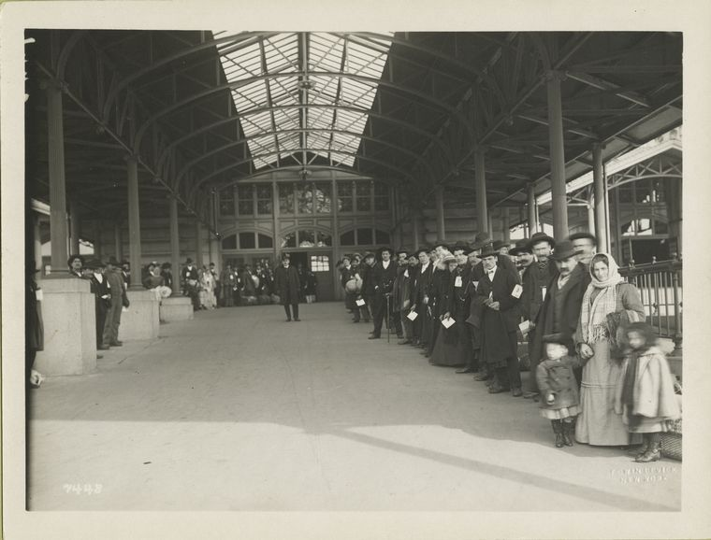
SOME HISTORICAL BACKGROUND
Historically Polish, Russian, Jewish and German minorities have lived in Latvia for hundred of years.

Slide 5
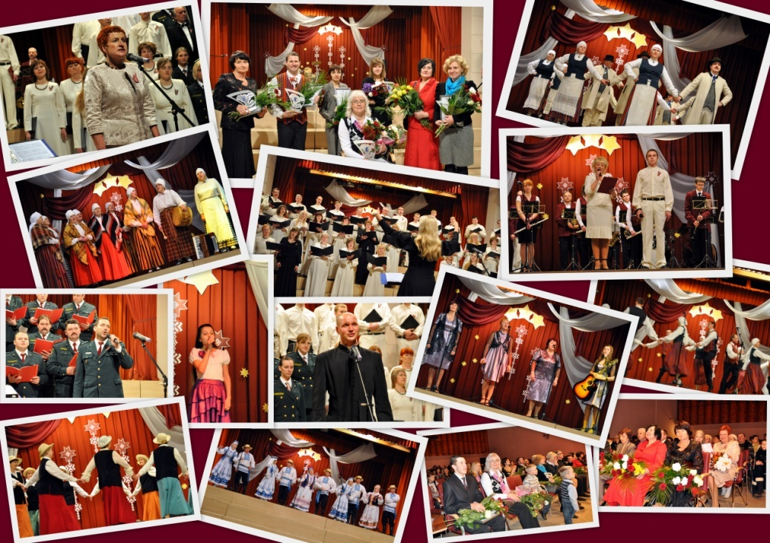
SOME HISTORICAL BACKGROUND
These minorities have general cultural rights - freedom of artistic expression.
They also have the rights of ethnic minorities –
"to preserve and develop their language and their ethnic and cultural identity“.

Slide 6
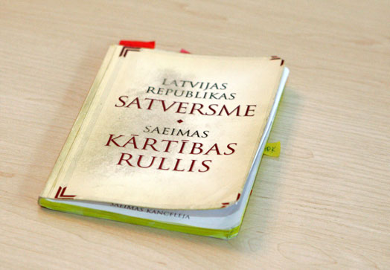
SOME HISTORICAL BACKGROUND
These rights are recognised by the Constitution of the Republic of Latvia
(1922, c. 8).

Slide 7
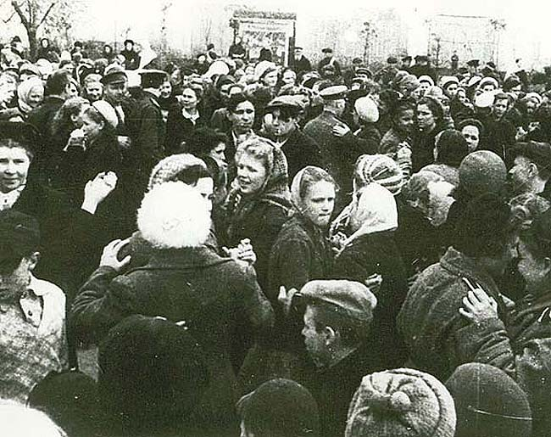
SOME HISTORICAL BACKGROUND
Today, Latvia's ethnic and cultural diversity is closely connected to demographic changes that came as a result of the two World Wars and labour migration during Latvia's years as part of the Soviet Union
(1940-1991).

Slide 8
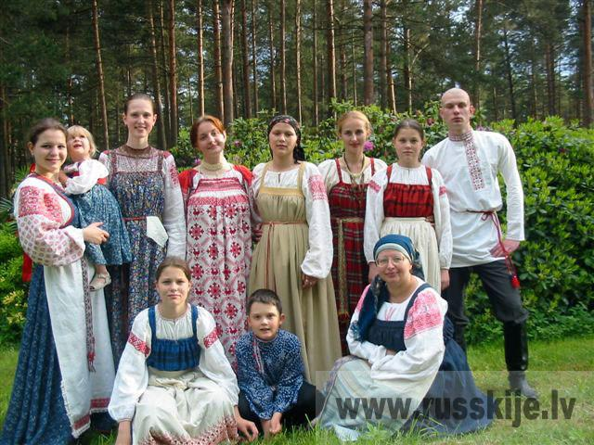
SOME HISTORICAL BACKGROUND
According to official figures, about 40% of the population of Latvia is made up of ethnic minorities.
The Russian minority is the biggest - 27.8% of the population of Latvia.

Slide 9
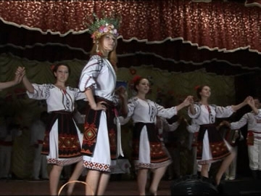
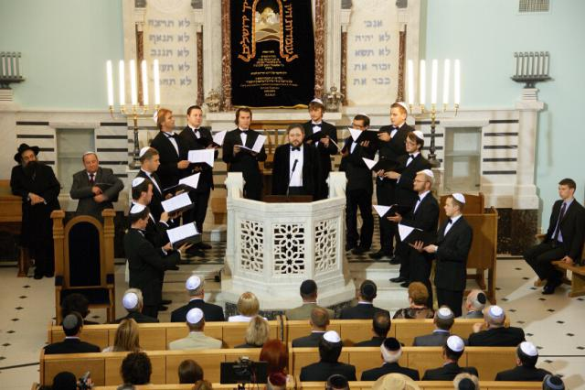
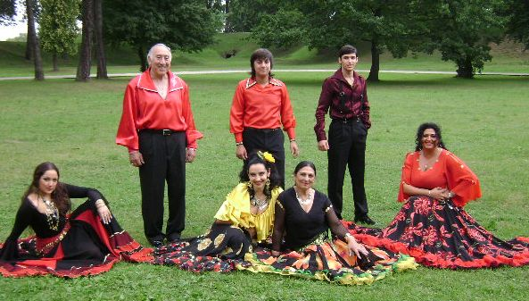
SOME HISTORICAL BACKGROUND
Roughly 13% are made up by other minorities such as Belarussians, Ukrainians, Poles, Lithuanians, Jews, Roma, Germans, Estonians and Livonians.

Slide 10
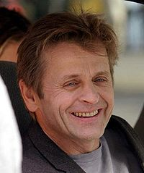
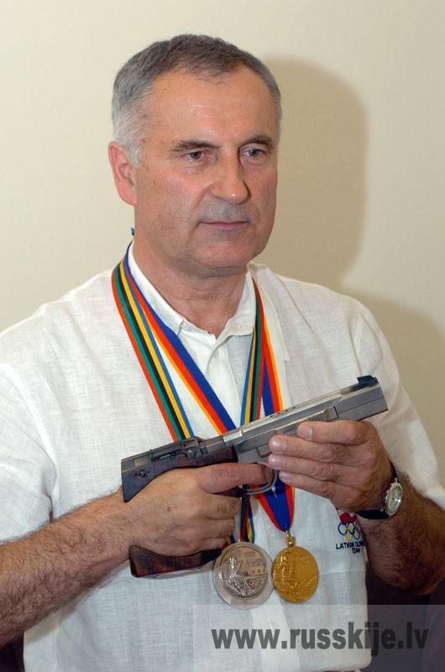
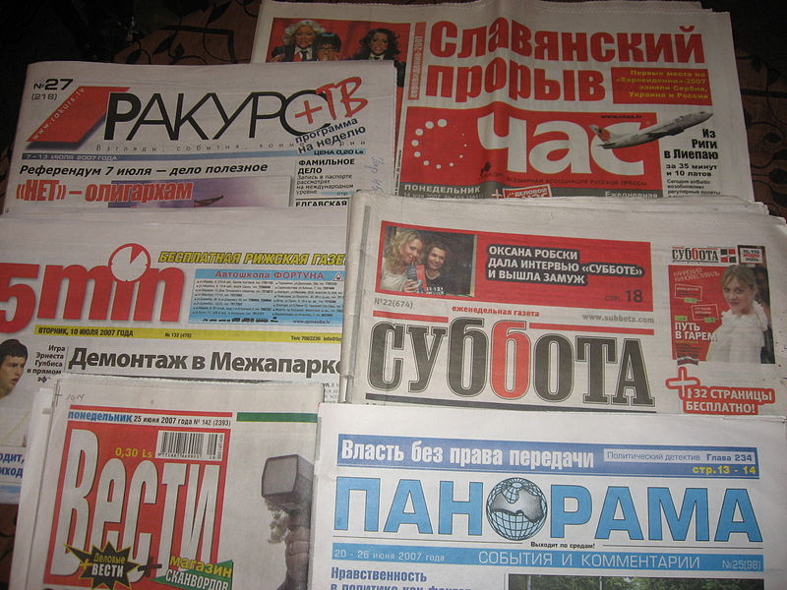
SOME HISTORICAL BACKGROUND
Today the Russian speaking population constitutes about 37% of the population and is larger than the ethnic Russian minority because a majority of Belorussians, Ukrainians and people from other post Soviet countries also have Russian as their mother tongue.

Slide 11
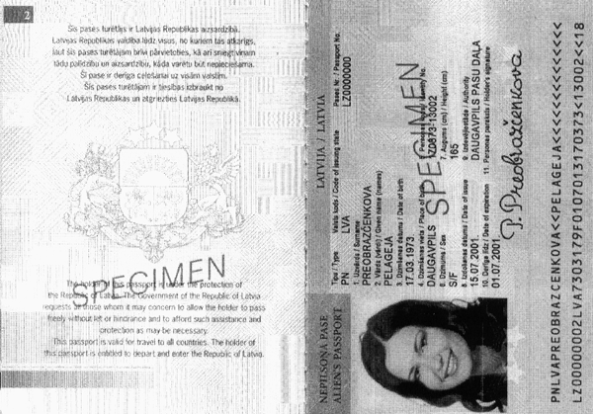
SOME HISTORICAL BACKGROUND
The situation in Latvia is more complicated because of the fact that not all the inhabitants are citizens of Latvia.

Slide 12
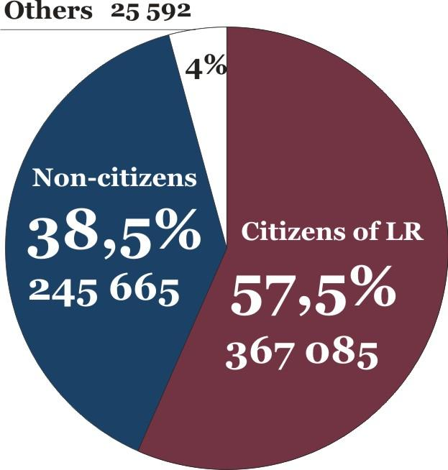
SOME HISTORICAL BACKGROUND
A large number of Russian speaking in Latvia are non-citizens –
in 2010 about 38 % of them were non-citizens.

Slide 13
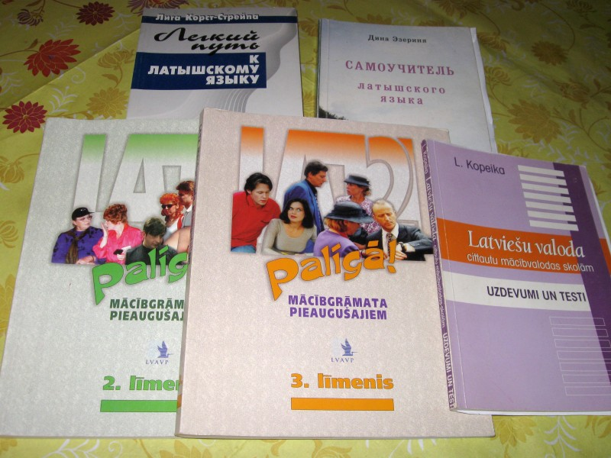
SOME HISTORICAL BACKGROUND
Concerning other ethnic minorities, Latvia has chosen the "social cohesion approach" –
a main goal is integrating immigrants and having them to learn the language and traditions of the host country.

Slide 14
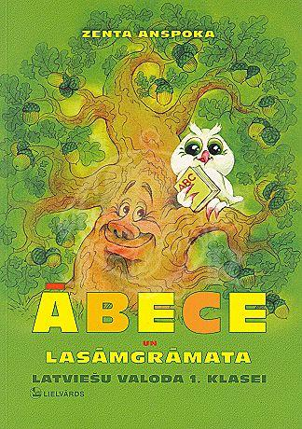
SOME HISTORICAL BACKGROUND
Since 2011 the Ministry of Culture is responsible for integration and this integration must be based on the Latvian language.

Slide 15
DIVERSITY, IDENTITY AND CITIZENSHIP
IN OUR SCHOOL
Since Latvia regained its indepedndence in 1991, a lot of Russian speaking students started to attend Latvian school.
They study all school subjects in Latvian even if the mother tongue in the family is Russian.

Slide 16
DIVERSITY, IDENTITY AND CITIZENSHIP
IN OUR SCHOOL
We celebrate all state holidays at school during the school year and some of them are connected with our history.

Slide 17
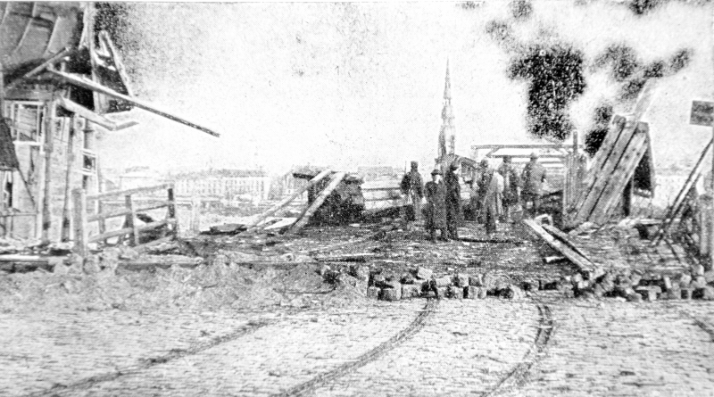
DIVERSITY, IDENTITY AND CITIZENSHIP
IN OUR SCHOOL
11th November –
Lāčplēsis Day
(The Bear Slayer Day).
In 1919 the defenders of Riga defeated the pro-German Voluntary Western Russia army or simply the army of Bermont.

Slide 18
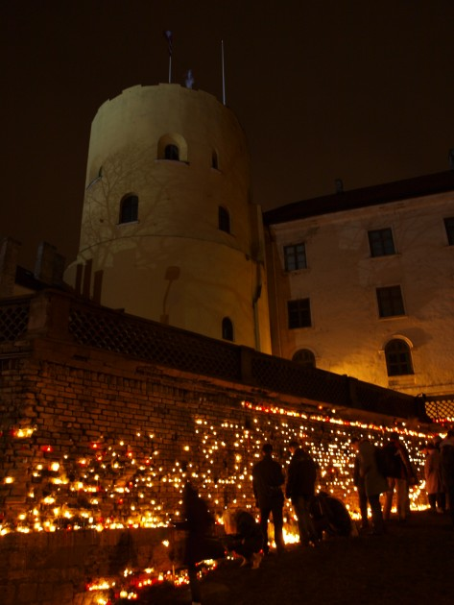
DIVERSITY, IDENTITY AND CITIZENSHIP
IN OUR SCHOOL
It’s a tradition to put the candles in 11th November Embankment – to remember those who died fighting for our freedom in1919.

Slide 19
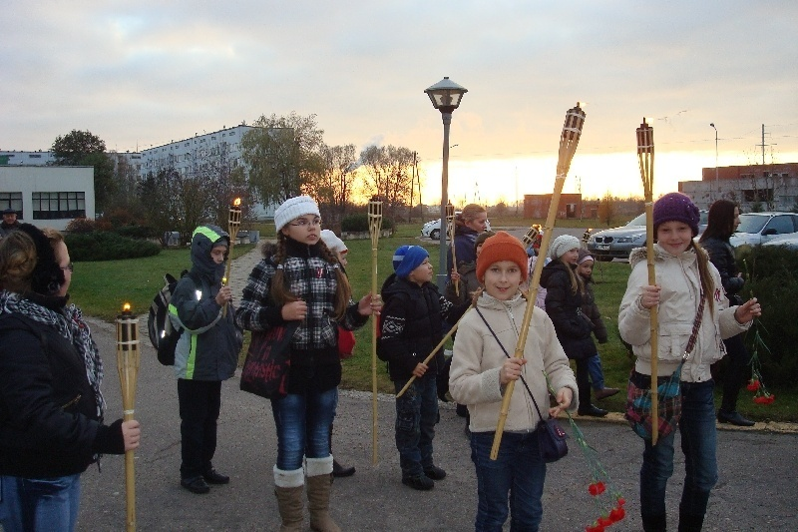
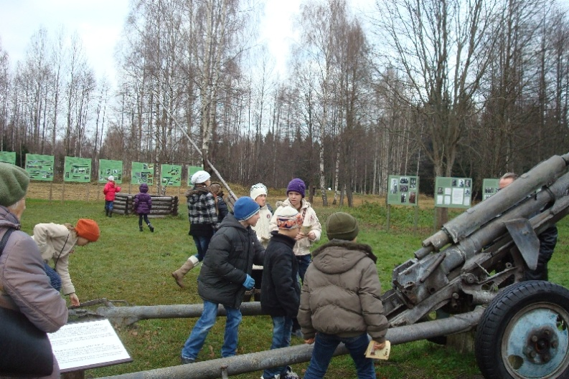
DIVERSITY, IDENTITY AND CITIZENSHIP
IN OUR SCHOOL
Our youngest students go to a torch procession on 11th November.
They also attend historical places connected with battles for freedom.

Slide 20
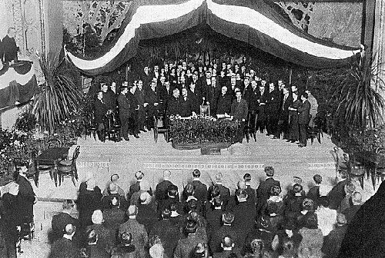
DIVERSITY, IDENTITY AND CITIZENSHIP
IN OUR SCHOOL
18th November –
The Latvian Independence Day.

Slide 21
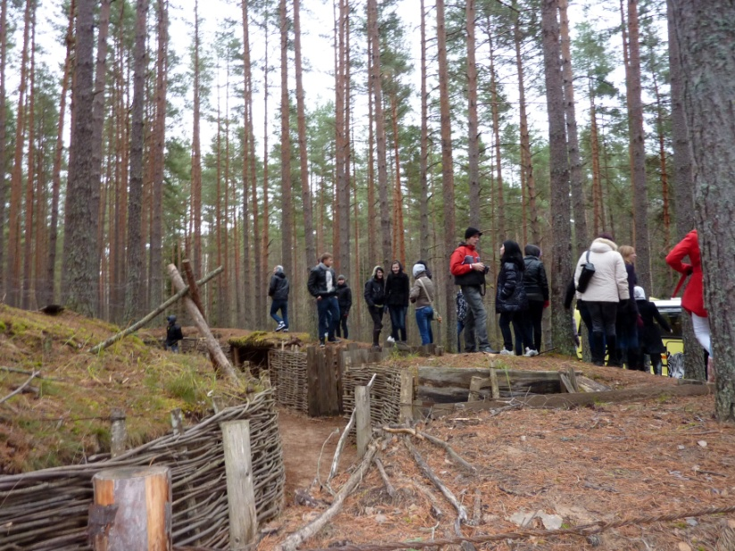
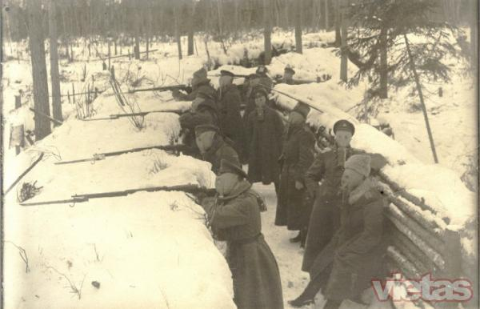
DIVERSITY, IDENTITY AND CITIZENSHIP
IN OUR SCHOOL
Our students attend Tīreļpurvs – the place that is close to our city and where Christmas battles took place (January 1917).

Slide 22
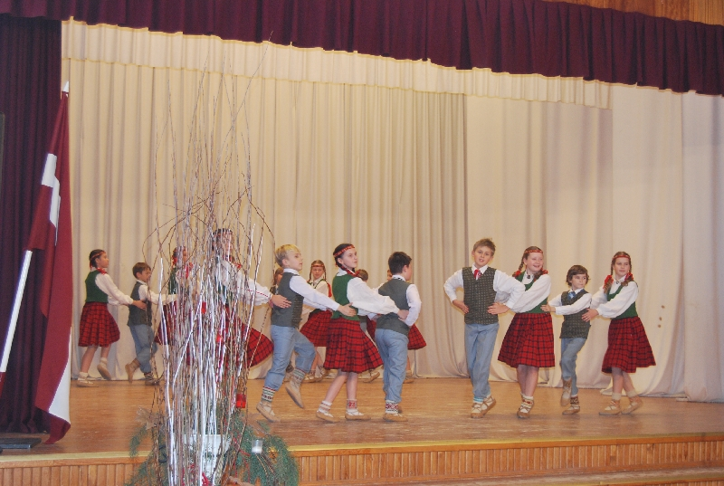
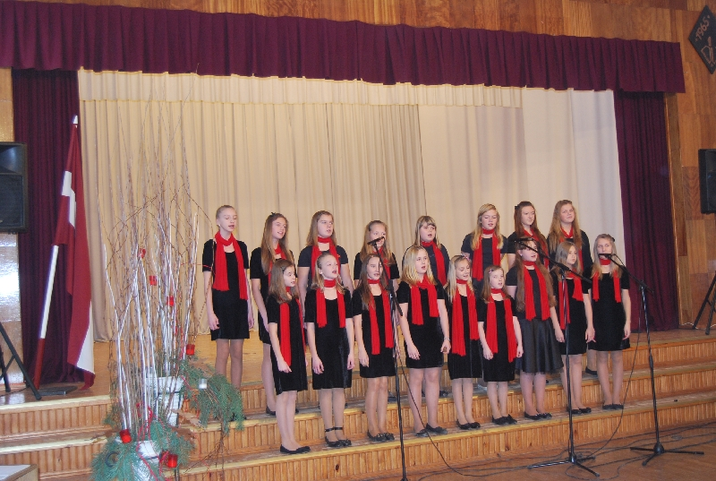
DIVERSITY, IDENTITY AND CITIZENSHIP
IN OUR SCHOOL
The day before the 18th November we organise the concert.
Some time before this date, the students and the teachers vote for the “Class Soul” and “Teacher’s Soul” - the people we can trust on and who have done a lot for the class or school.

Slide 23
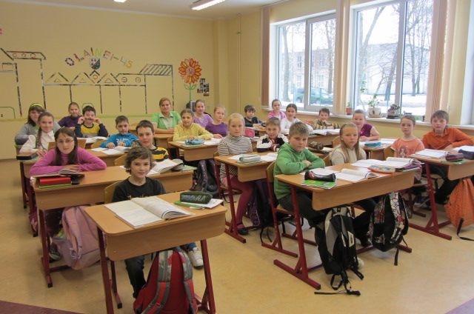
DIVERSITY, IDENTITY AND CITIZENSHIP
IN OUR SCHOOL
Students of forms 4 made paper figures in traditional folk costumes from all parts of Latvia.

Slide 24
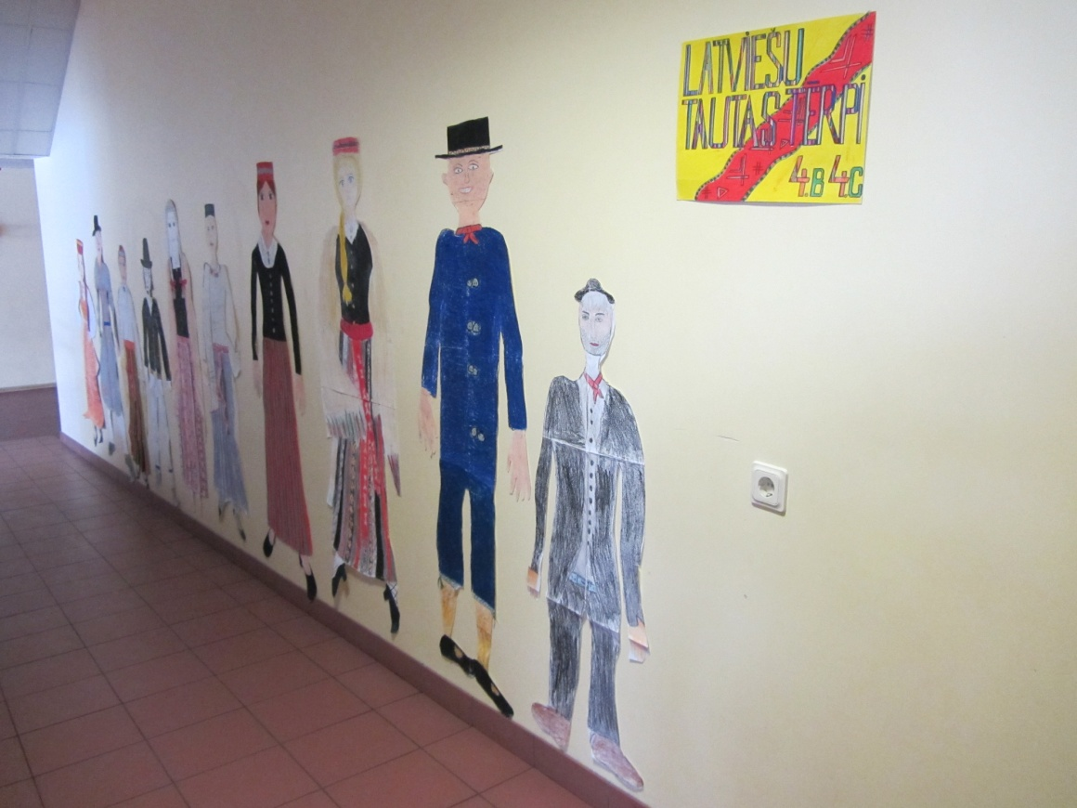
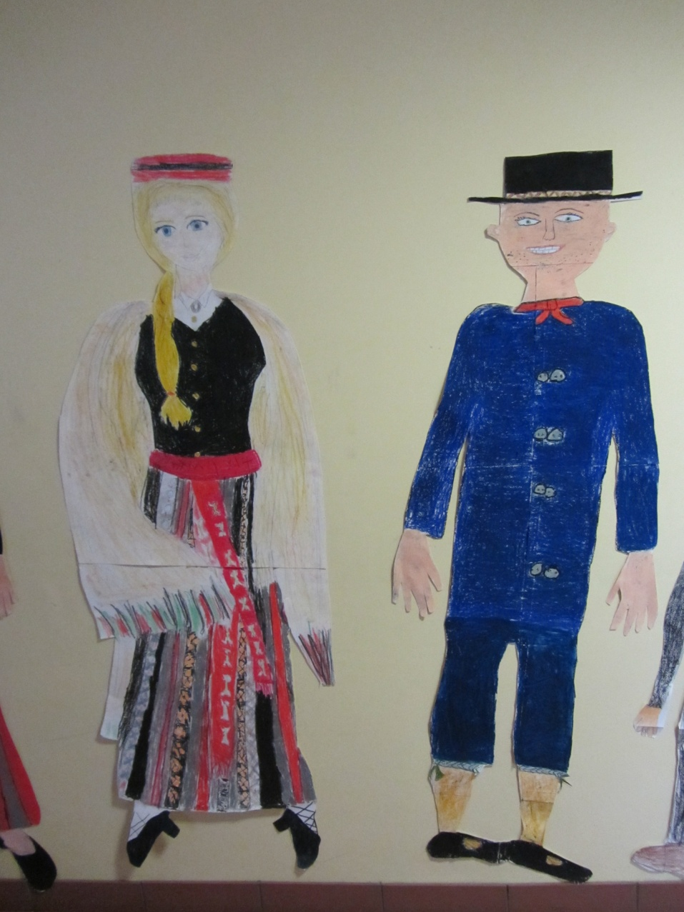
DIVERSITY, IDENTITY AND CITIZENSHIP
IN OUR SCHOOL

Slide 25
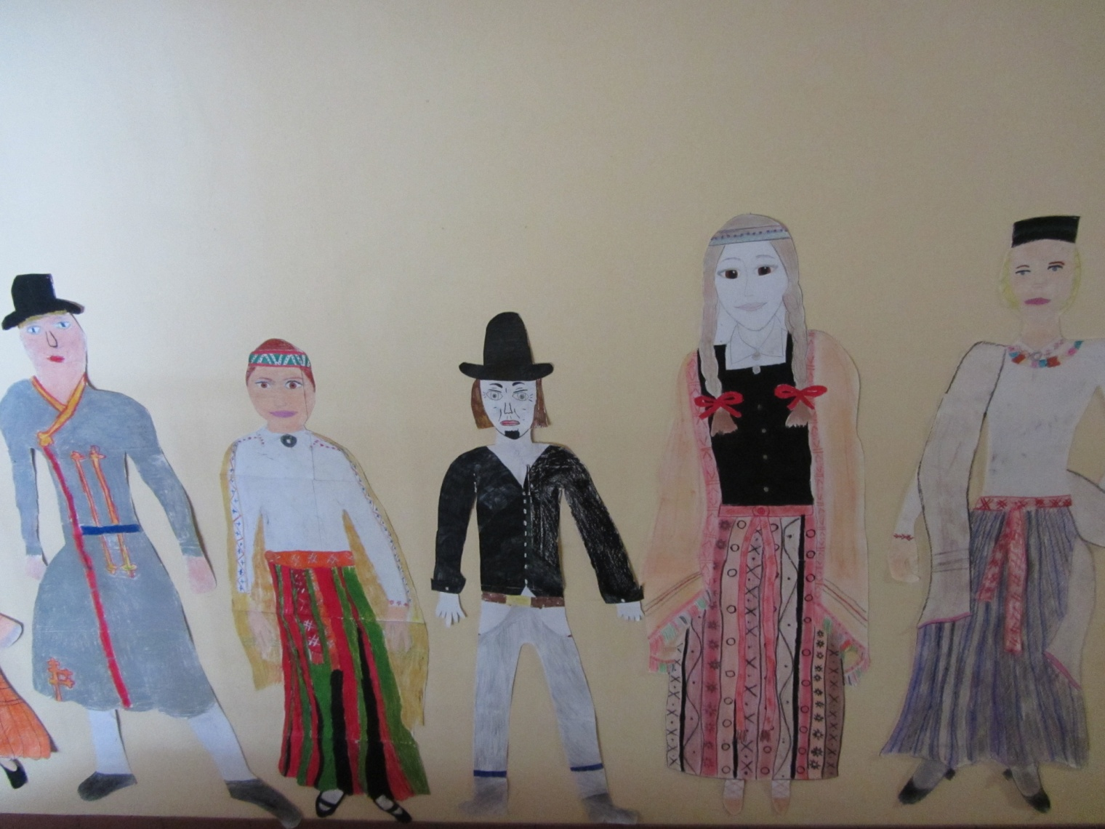
DIVERSITY, IDENTITY AND CITIZENSHIP
IN OUR SCHOOL

Slide 26
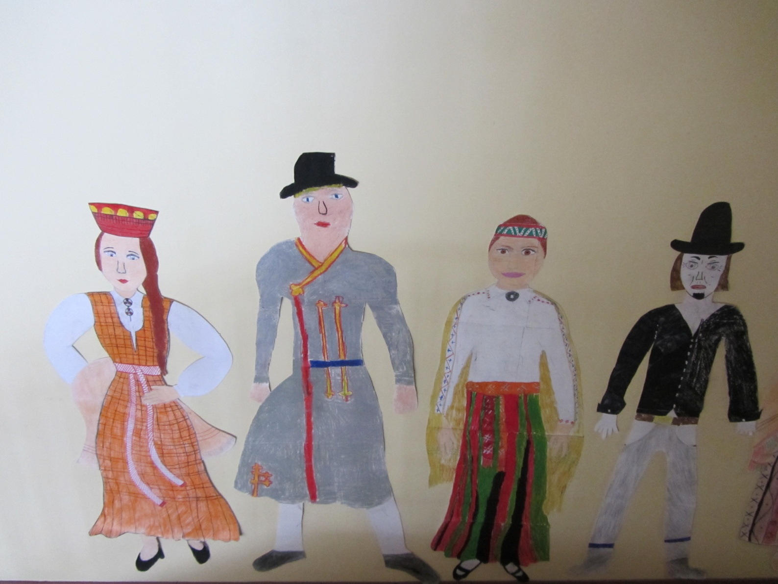
DIVERSITY, IDENTITY AND CITIZENSHIP
IN OUR SCHOOL

Slide 27
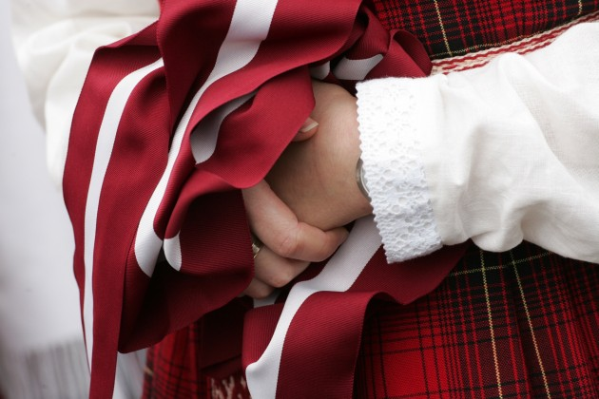
THANK YOU FOR ATTENTION !

